Slide 1
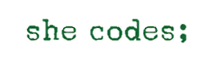

Smile Detection
Final Project
Emuna Lipsker

Slide 2
About me
Holding an M.Sc. in Mathematics
Thesis on Analysis, with geometrical aspects
This is my first course in she codes;
About The Project
Detect smiling faces in a video, and displaying it on the video.
Using pre-trained model for face detection
Build deep image classifier for smile recognition

Slide 3
Smiling classifier
Searching for an open source dataset
Choosing model
Training and improving
Beginning accuracy 80%
Fixing unbalanced data by creating balanced batches – accuracy 89.8%
Save original and right-left flip image – accuracy 92.7%
Image transforms with different probability – accuracy 94%

Slide 4
The pipeline
Loop through video to extract frame
Using pre-trained model for face detection
Classifying smiling/not smiling for each face in frame
Track over faces
Correct smiling predictions by sliding window
Loop through video
Drawing boxes around each face. Green box for smiling, red box for not smiling

Slide 5



Collect Data per Frame
Face Detection (pre-trained)
Smile Classifier
Resize & greyscale
Smile /
Not a Smile
Face Objects
Each face object contain face coordinate and smiling predictions in all frames
Frame Data

Slide 6
Correct Predictions
Face Object
coordinates_in_frames = [……] predictions_in_frames = [0, 0, 1, 1, 1, 0, 1, 1….]
Face Object
coordinates_in_frames = [……] predictions_in_frames = [0, 0, 1, 1, 1, 1, 1, 1….]

Slide 7
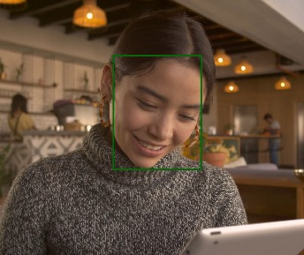
Output Frame

Slide 8
Error Analysis
Manually annotating few video, and test accuracy
Fix jittering between smiling/not smiling by sliding window technique
Avoid some mistaken detected face: in process
TO DO - Smile classifier sometimes fail in:
Cry
Hand over mouth
A very rotated face to the side

Slide 9
Edge Cases
Cat, flower
Very low/high resolution
Moving camera
Few people
Someone disappear or show up in the middle of the video

Slide 10
Future Development
Examine other smile classifier models and their performance
Correct tagging mistakes by hand
Decrease pipeline running time
Arrange code to be object-oriented
Improve UX by solving ‘to-do’ and ‘in-process’ appears in Error Analysis.

